Slide 1

AGRICULTURAL KNOWLEDGE, MADE CONVERSATIONAL
KrishiMitra AI
A conversational companion for finding, understanding, and using agricultural knowledge.
From practical crop guidance to supported agricultural schemes.

Slide 2
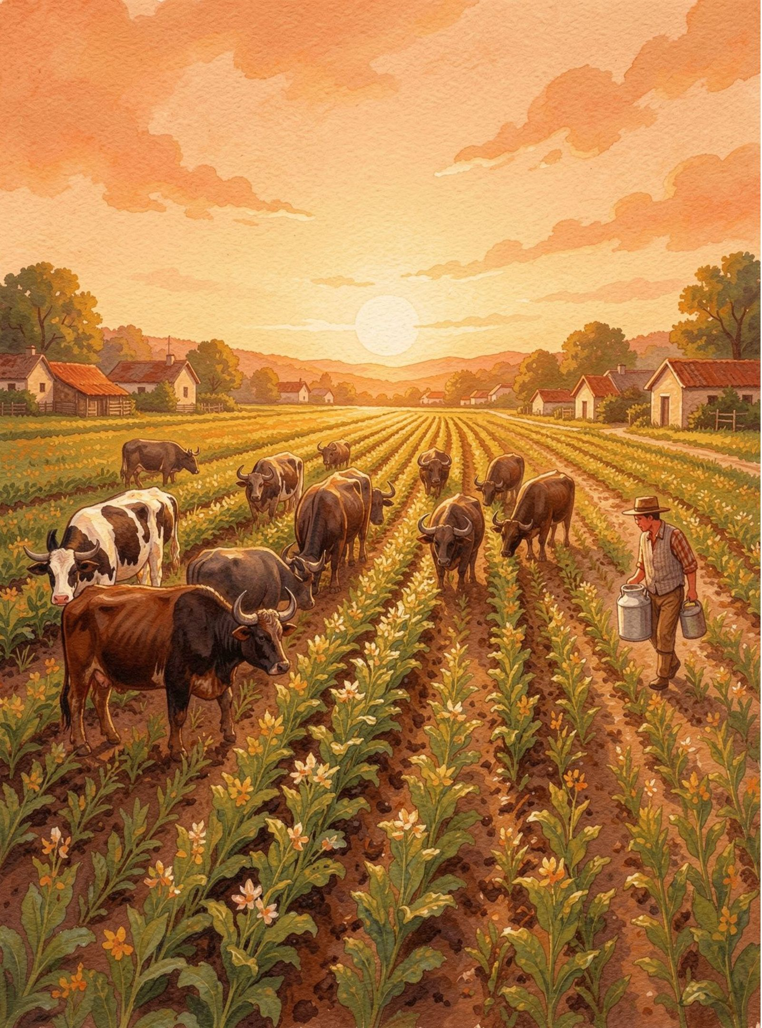



THE PROBLEM
Every farming question deserves a clearer path to an answer
Crop cultivation, soil health, irrigation, pests, diseases, and schemes all demand practical decisions.
Useful information is often scattered across documents, websites, research papers, and official resources.
KrishiMitra AI brings supported knowledge sources into one conversational place.

Slide 3
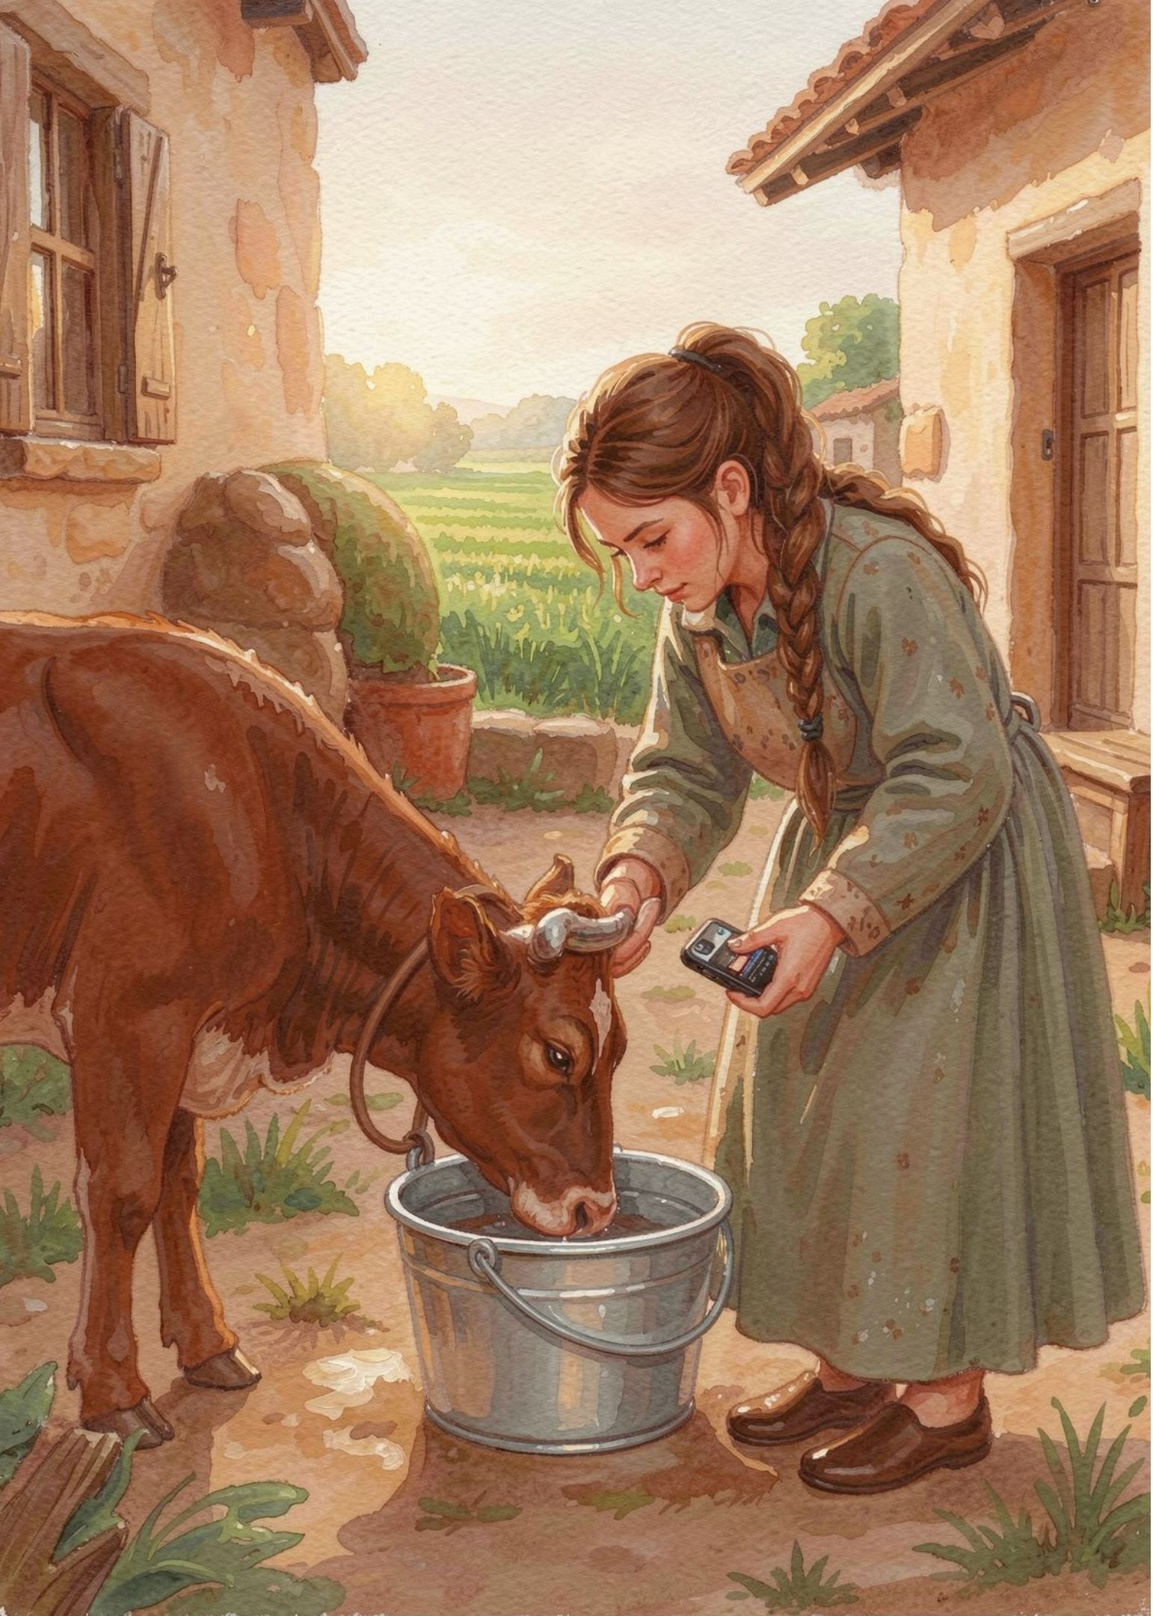
THE EXPERIENCE
Ask in everyday language. Explore the answer together.
KrishiMitra AI is designed for farmers and people interested in agriculture who want useful information without manually searching every source.
01
02
03
Ask a question
Get a clear explanation
Ask follow-ups until the topic makes sense

Slide 4
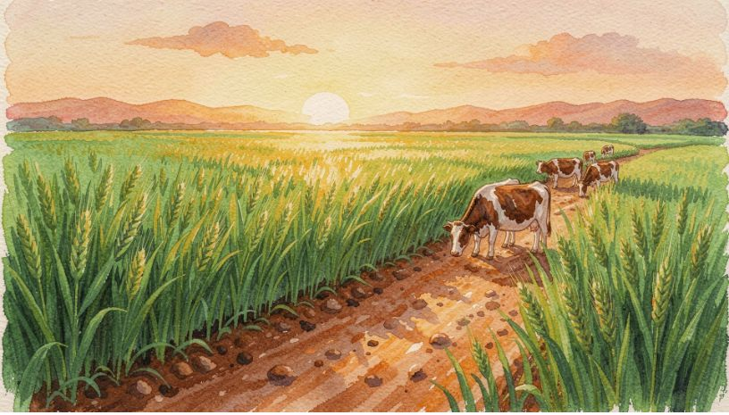
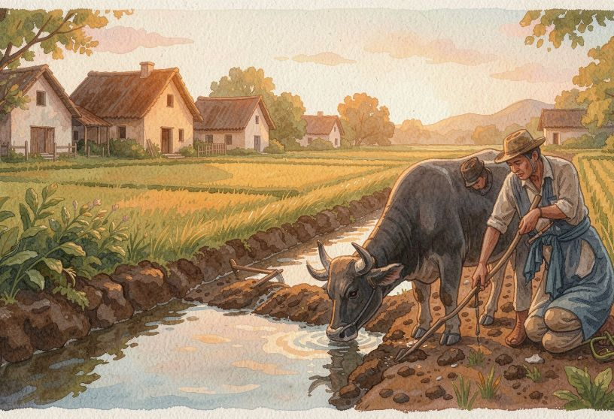
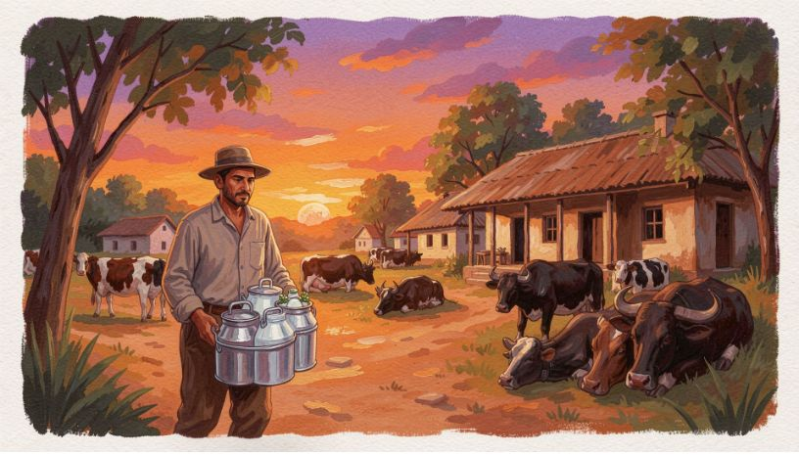
PRACTICAL COVERAGE
From crop guidance to agricultural schemes
Start with the question in front of you. Move toward the source and explanation that help you act.
Understand farming topics
Find supported resources
Explore crop conditions
Explore cultivation practices and the questions behind them.
Bring crop, soil, and irrigation information into the conversation.
Learn from available pest, disease, scheme, and agricultural material.

Slide 5

HOW IT WORKS
Behind the conversation is a retrieval engine
In simple terms: look first, answer second.
Add Sources
Extract & Split
Retrieve Context
Generate Answer

Slide 6
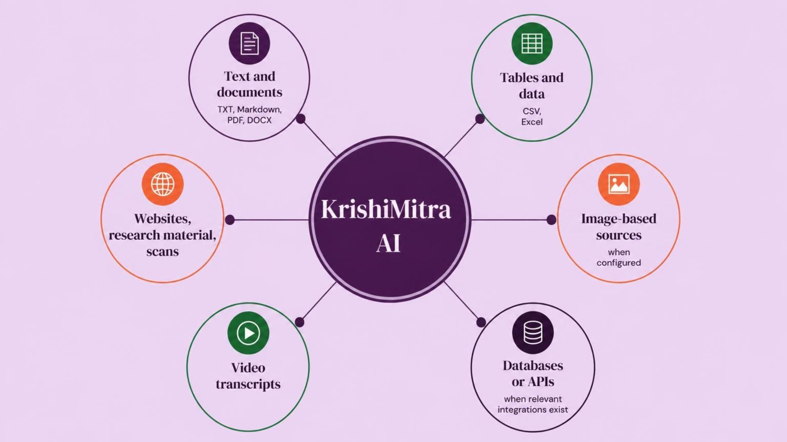
THE KNOWLEDGE LAYER
One assistant, many possible knowledge sources
Coverage depends on what is connected and enabled. The assistant grows with the knowledge collection behind it.

Slide 7
ASK BETTER
Name the crop, topic, or problem
01
Better questions create better starting points
02
Add region, crop stage, soil conditions, or symptoms
03
Ask one thing at a time
04
Request a simpler explanation when needed
05
Check the original source and its date when references are provided
Specific context helps the system find a more useful place to begin.

Slide 8
USE WITH JUDGMENT
Useful does not mean infallible
AI can make mistakes, and the knowledge available to it may be incomplete or outdated. Use answers to explore—not replace current sources, local context, or professional judgment.
Check what can change
Check what depends on place
Weather, market prices, and current scheme details need up-to-date sources.
Recommendations can vary by region, season, soil, climate, and crop variety.
Verify high-impact decisions
THE PRINCIPLE
Use the answer as a starting point, then verify the decision.
Verify high-impact decisions with official guidance or a qualified agricultural professional.

Slide 9
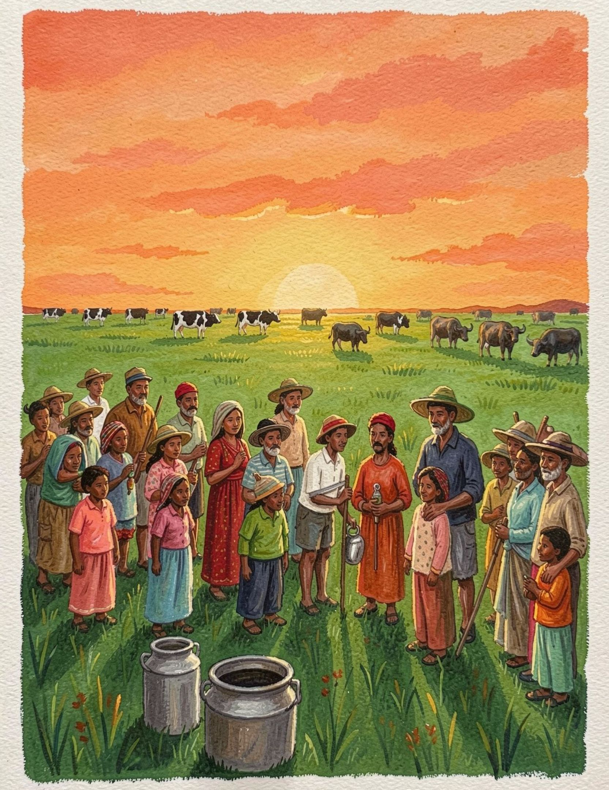
THE VISION
Make agricultural knowledge easier to explore
KrishiMitra AI combines document retrieval with AI-generated explanations so users can move from scattered information to a more useful conversation.
As trusted sources and integrations grow, the assistant can grow with them.

